Slide 1
BIKE SALES Analytical Report
By {OLUWASEYI BABAFEMI}

Slide 2

Project analysis slide 2
Analytical report
Analytical report
PROJECT DESCRIPTION
KEY QUESTIONS
PROJECT
FINDINGS & INSIGHTS
VISUALISATION
SUMMARY
RECOMMENDED ACTIONS

Slide 3
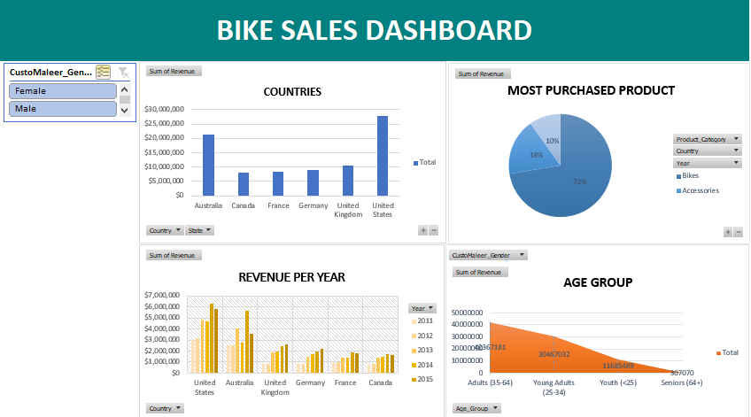

Slide 4
Project analysis slide 8
Analytical report
PREOJECT DESCRIPTION
.
To better understand the sales of bike across Canada, France, Australia, United States, United Kingdom and Germany. As well as identifying trends and patterns
This will help us to:
Identify for which age group and gender impacts sales
Create targeted strategies to increase the countries revenues.
.

Slide 5
Project analysis slide 8
Analytical report
KEY QUESTIONS
.
Which countries generate the highest and lowest revenue over the years?
What is the impact of age on sales across the countries?
Which product generates the highest revenue over the years?
How much profit does each country make based on gender?
What are the 10 most popular product? Also, include their product category
.

Slide 6
Project analysis slide 8
Analytical report
Which countries generate the highest and lowest revenue over the years?
Sum of Revenue | Column Labels
Row Labels | 2011 | 2012 | 2013 | 2014 | 2015 | 2016 | Grand Total
United States | $3,032,895 | $3,128,572 | $4,877,529 | $4,701,201 | $6,256,468 | $5,780,433 | $27,777,098
Australia | $2,527,984 | $2,545,407 | $4,074,626 | $2,782,540 | $5,687,580 | $3,578,258 | $21,196,395
United Kingdom | $823,481 | $834,885 | $1,853,657 | $1,986,340 | $2,476,886 | $2,600,379 | $10,575,628
Germany | $833,603 | $835,188 | $1,446,051 | $1,696,626 | $1,925,113 | $2,220,143 | $8,956,724
France | $946,624 | $962,153 | $1,425,103 | $1,409,072 | $1,871,282 | $1,800,511 | $8,414,745
Canada | $787,379 | $827,590 | $1,440,361 | $1,464,413 | $1,728,374 | $1,658,065 | $7,906,182
Grand Total | $8,951,966 | $9,133,795 | $15,117,327 | $14,040,192 | $19,945,703 | $17,637,789 | $84,826,772
.
.

Slide 7
Project analysis slide 8
Analytical report
.
FINDINGS
The above visualization shows that united states made the highest revenue over the years while Canada made the lowest.
.

Slide 8
Project analysis slide 8
Analytical report
2. What is the impact of age on sales across the countries?
Row Labels | Sum of Revenue
Adults (35-64) | 42367181
Young Adults (25-34) | 30467032
Youth (<25) | 11685489
Seniors (64+) | 307070
Grand Total | 84826772
.
FINDINGS
This analysis revealed that the sum of revenue increased as the ages increased, got to it’s peak at the age group of Adults and then decreased drastically at the age group of seniors. This means that the age group of Seniors purchased the least while the age group of Adults purchased the most.
.

Slide 9
Project analysis slide 8
Analytical report
3. Which product category generates the highest revenue?
Row Labels | Sum of Revenue
Bikes | 61434484
Accessories | 15022766
Clothing | 8369522
Grand Total | 84826772
.
.
FINDINGS
From the visualization above, I found “Bikes” to be the product category that generates the highest revenue.

Slide 10
Project analysis slide 8
Analytical report
4. How much profit does each country make based on gender?
Row Labels | Sum of Profit
Australia | 6740522
Female | 3421486
Male | 3319036
Canada | 3702019
Female | 1666794
Male | 2035225
France | 2872082
Female | 1384572
Male | 1487510
Germany | 3349991
Female | 1762290
Male | 1587701
United Kingdom | 4383987
Female | 2196832
Male | 2187155
United States | 10997638
Female | 5209845
Male | 5787793
Grand Total | 32046239
.
.
FINDINGS
I deduced that the male gender purchased the most, thereby generating the highest sum of profit.

Slide 11
Project analysis slide 8
Analytical report
5. What are the 10 most popular product? Also, include their product category
Row Labels | Sum of Revenue
Road-150 Red, 62 | $3,810,023
Mountain-200 Black, 38 | $3,345,501
Road-150 Red, 52 | $3,152,610
Road-150 Red, 56 | $3,142,811
Mountain-200 Silver, 42 | $3,070,174
Mountain-200 Silver, 38 | $3,011,267
Road-150 Red, 48 | $2,955,506
Mountain-200 Black, 46 | $2,756,837
Mountain-200 Black, 42 | $2,630,865
Mountain-200 Silver, 46 | $2,364,776
Grand Total | $30,240,370
.
.
FINDINGS
After creating a pivot table and visualization, I found that out that the top 10 most popular product are under the product category “Bikes”

Slide 12
Project analysis slide 8
Analytical report
SUMMARY OF FINDINGS
Top Products:
About 72% of revenue comes from products under product catergory “Bikes”
Age Group:
The “Adults” age group purchased the most while the “Senior” age group purchased the least
Top country:
The united states made the highest revenue
Gender:
.
.
The male gender purchased the most, thereby generating the highest sum of profit

Slide 13
Project analysis slide 8
Analytical report
RECOMMENDED ACTIONS
.
Product recommendations:
Focus on fascinating bike designs that not only attract the Adult age group but also the Young Adults age group. Since those are the major customers.
Marketing recommendations:
The dataset tells us that Canada and France yield a relatively low revenue compared to other countries. Marketing and advertising campaigns should therefore be improved in these countries.
.

Slide 14
Thank you!

